Slide 1
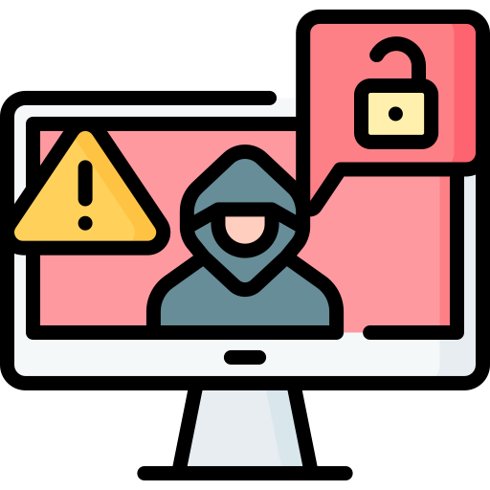
Ransomware &
Social Engineering
Presentation in Security Management and Cyber Laws

Slide 2

Group Members
02. Mayur Behere
04. Nishad Wanjari
07. Parth Zarekar
10. Krishnaraj Thadesar
24. Singh Soubhagya
25. Sourab Karad

Slide 3

Contents
Intro to ransomware
Types of ransomware attacks
Examples of ransomware attacks
Demo
How to avoid them
Dos and don'ts during the attack
What is social engineering, definition
Examples of social engineering in action
Measures to avoid and resolve

Slide 4
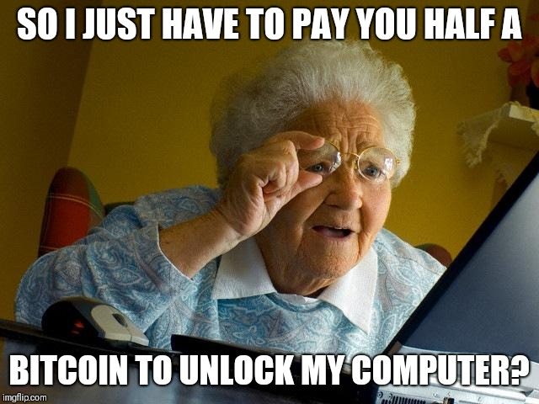
Ransomware Chronicles
HECKER HAI BHAI, HECKER☠️
03. Mayur Behere

Slide 5
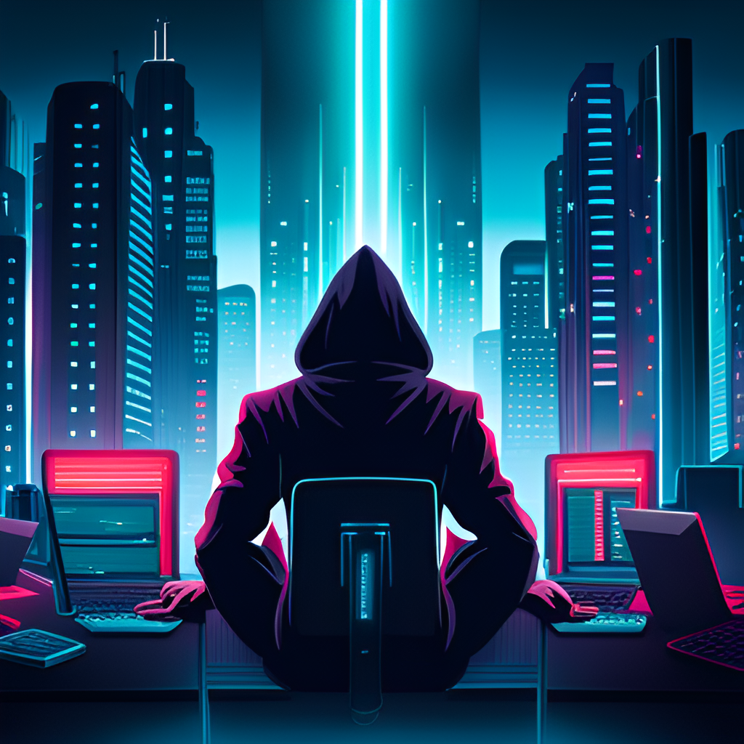
Lights ,Camera , Hacktion!
CYBER EXTORTION ☠️
Ransomware is a type of malicious software designed to block access to a computer system or data until a sum of money is paid. It is often spread through phishing emails, malicious websites, or infected downloads.
Once installed on a victim's computer, ransomware can encrypt files, rendering them inaccessible, or lock the entire system, making it impossible to use. The attacker then demands payment, usually in cryptocurrency, in exchange for a decryption key or to unlock the system.

Slide 6

Ransomware 101: Behind the Cyber Curtains
THE POWER OF YOUR PC , IN THE PALM OF MY HANDS
Ransomware attacks come in different forms, each with its own unique characteristics and methods of operation. The most common types of ransomware attacks are encrypting ransomware, locker ransomware, and scareware
PAISA DE ! PAISAAAAA !!!

Slide 7
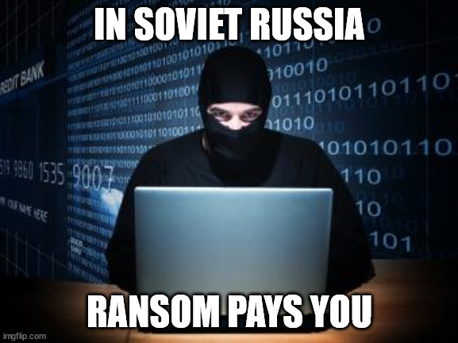
Encrypting Ransomware
Encrypts victim's files, demanding ransom for access.
Devastating consequences for individuals and businesses.
Example: WannaCry attack (May 2017) affected 200,000+ computers, exploited Windows vulnerability, demanded bitcoin payment.
WARNING! THIS HAPPENS ONLY IN RUSSIA

Slide 8
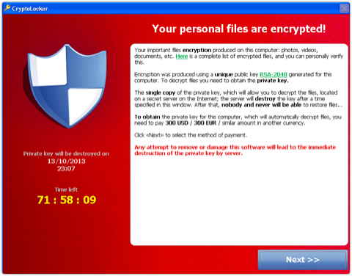
Locker Ransomware
Locks victim's device, seeks ransom for release.
Uses social engineering tactics, threatens file deletion.
Victim risks data loss and identity theft.
Caution: Keep antivirus updated, avoid suspicious sources.

Slide 9
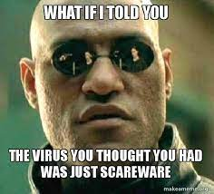
Scareware
Tricks users into buying fake antivirus software.
Mimics real security alerts, installs additional malware.
Leads to financial loss, data and identity theft.
Awareness key: Recognize scareware signs, protect against attacks.

Slide 10
It’s Happening!
Encrypting Ransomware:
WannaCry (2017): One of the most infamous ransomware attacks, WannaCry affected over 200,000 computers across 150 countries. It exploited a Windows vulnerability and demanded Bitcoin payments for decryption.
CryptoLocker (2013): CryptoLocker was one of the earliest encrypting ransomware attacks. It spread via email attachments and encrypted victims' files, demanding payment for decryption.

Slide 11
Locker Ransomware:
FBI Locker (2012): This ransomware masqueraded as an official warning from the FBI, accusing victims of illegal activities. It locked victims' devices and demanded payment to unlock them.
Police Trojan (2011): Similar to FBI Locker, this ransomware impersonated law enforcement agencies and claimed victims had committed crimes. It demanded payment to avoid legal consequences.

Slide 12
Scareware:
WinFixer (2005): One of the earliest scareware attacks, WinFixer displayed fake pop-ups warning users of viruses and offering fake solutions. It tricked users into purchasing fraudulent antivirus software.
MacSweeper (2008): Targeting Mac users, MacSweeper used scare tactics to convince users their systems were infected. It prompted them to purchase fake security software.

Slide 13
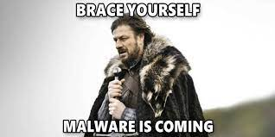
How to avoid them?
04. Nishad Wanjari

Slide 14

How to avoid them?
Keep Software Updated: Regularly update your operating system, software applications, and antivirus software.
Use Strong and Unique Passwords: Use complex passwords for all your accounts and avoid using the same password across multiple platforms.
Backup Regularly: Maintain regular backups of your important data and files. Ensure that backups are stored offline or in a secure cloud environment. Regularly test your backups to ensure they can be restored successfully.

Slide 15
How to avoid them?
Be Cautious with Email: Be wary of email attachments, links, and messages from unknown senders. Avoid clicking on suspicious links or downloading attachments from unverified sources.
Beware of Phishing: Cybercriminals often use phishing techniques to spread ransomware. Be cautious when interacting with unexpected emails, especially those that ask for sensitive information or urge you to take urgent actions.
Use Security Software: Install reputable antivirus and antimalware software on your devices. Keep them updated to ensure they can detect and prevent known ransomware threats.
Stay Informed: Keep yourself updated about the latest ransomware threats and cybersecurity practices to adapt your defense strategies accordingly.

Slide 16
Remember that no system is completely immune to ransomware attacks, but by following these practices, you can significantly reduce your risk and increase your ability to recover from an attack without paying a ransom.

Slide 17

Demo
- sb
Lav re to DEMO!
24. Saubhagya Singh

Slide 18
Introduction to Social Engineering
25. Sourab Karad
parth

Slide 19

What is it?
Social engineering is a psychological manipulation technique used to exploit human vulnerabilities and influence individuals into divulging confidential information, performing actions, or making decisions that they wouldn't normally do.

Slide 20
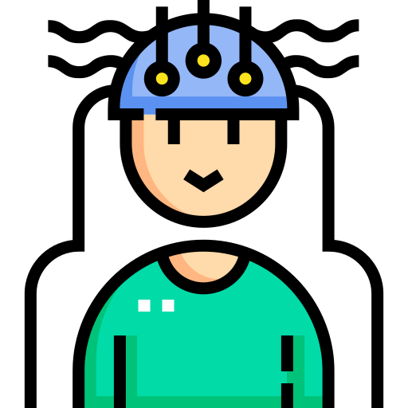
It is also …
Psychological manipulation technique used to exploit human vulnerabilities.
Importance of understanding social engineering in today's digital age where technology and human interaction are intertwined.

Slide 21


Who is a Social Engineer?
Who are these people? It could be a hacker in the USA who is out to do damage or disrupt. I
It could be a member of an Eastern Europe cybercrime mafia that is trying to penetrate your network and steal cash from your online bank account.
Or, it could be a Chinese hacker that is trying to get in your organization’s network for corporate espionage.

Slide 22

What are the Methods?
Pretexting
Phishing
Water holing
Baiting
Spear phishing
honeytrap

Slide 23
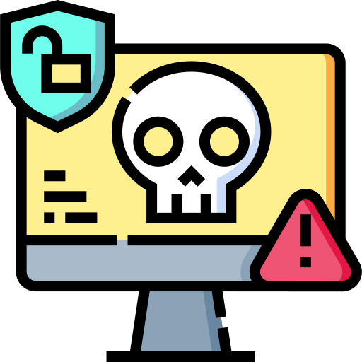
Evolution of Social Engineering
The term "social engineering" gained traction in the 20th century, describing the manipulation of societies for political or ideological purposes.
The evolution of social engineering traces a fascinating journey through history, revealing how psychological manipulation has adapted to the changing technological and societal landscapes

Slide 24
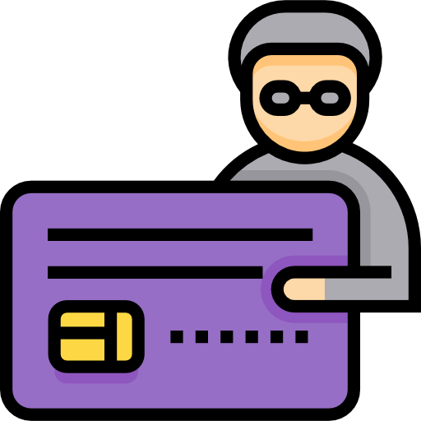
Examples of Software Engineering Attacks
10. Krishnaraj Thadesar
- krish

Slide 25





Scenarios
Fear
Greed
Curiosity
Helpfulness
Urgency

Slide 26
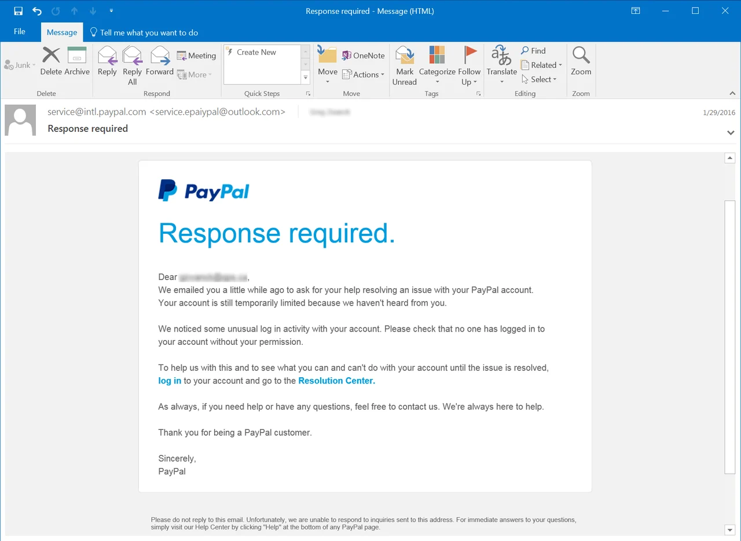

Slide 27
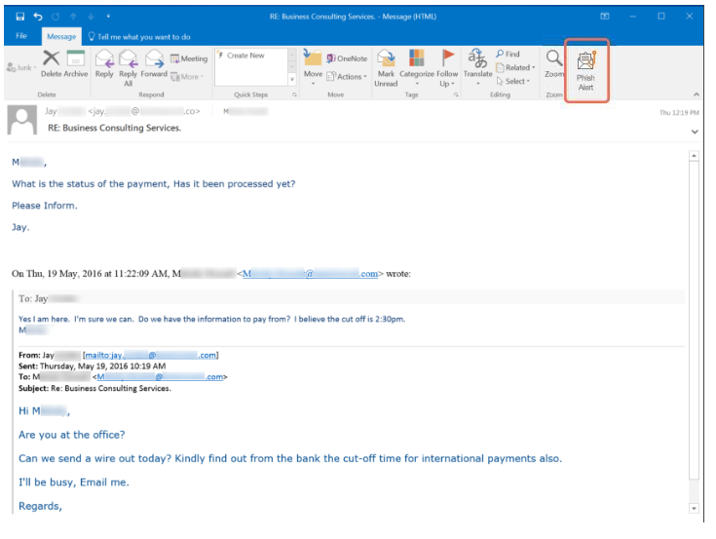

Slide 28
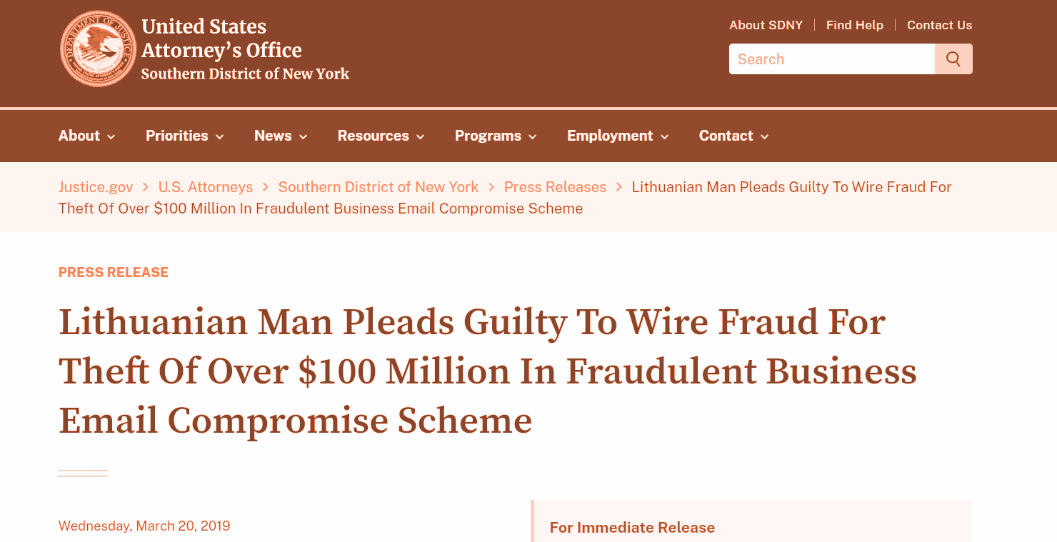

Slide 29
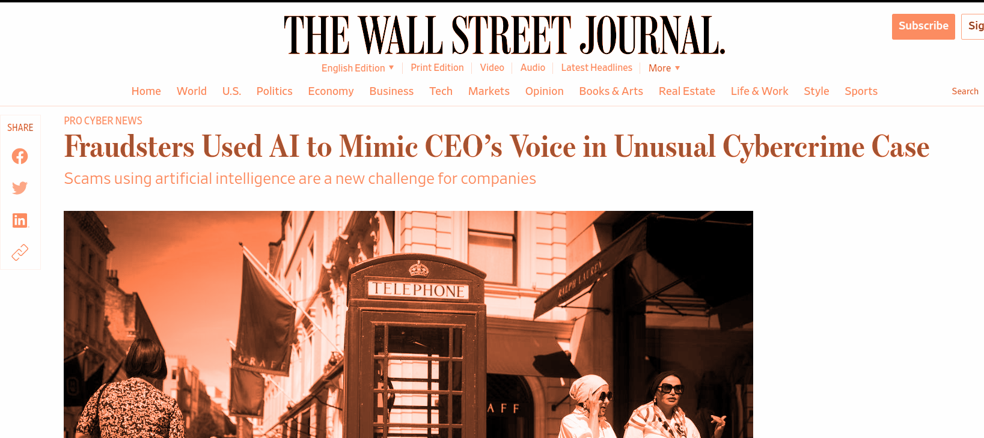

Slide 30
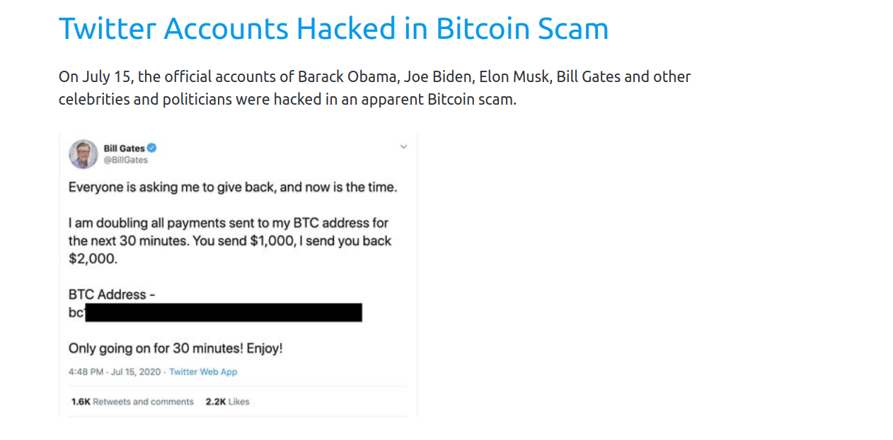

Slide 31

Measures to avoid and conclusion
7. Parth Zarekar
parth

Slide 32
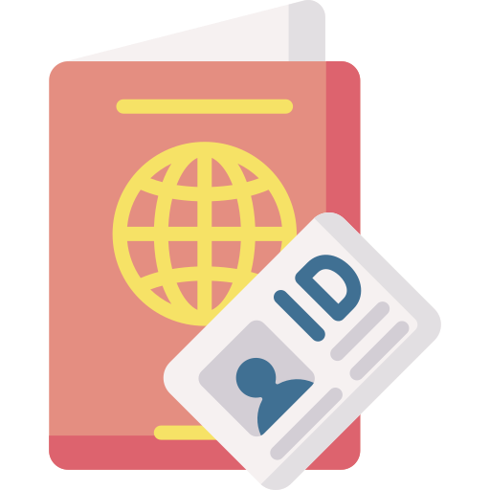
Verify Requests
Verify the Identity of the personal requesting sensitive Information

Slide 33

Secure Online Presence
Limit your Personal Information shared on Social Media

Slide 34

Use Strong Authentication
Implement Multi- Factor Authentication.

Slide 35
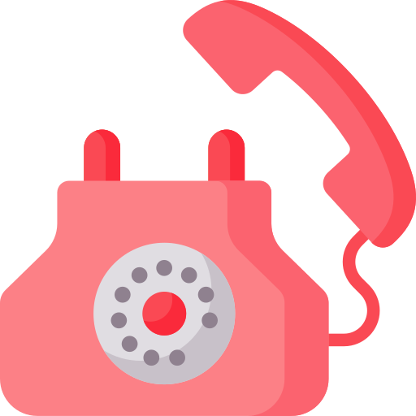
Be Skeptical Unsolicited Communication
Exercise Caution While receiving Email, Message, Calls from Unknown Sources

Slide 36

Guard Personal Information
Avoid Sharing Personal details Such as card details, password to unknown sources.

